Slide 1
Gamification web-application
By Ali Al-mugoter, Ali Tarraf, Steve Karim

Slide 2
Introduction
The project was to develop a web application for the gamification of big data. The data that is analyzed is data received from an inventory software, which keeps inventory of equipment that is used by teams. These teams should utilize the inventory software whenever they have jobs. Check if inventory is being returned. The data will be analyzed, and a scoring system will rank the teams, based on how much they utilized the software and if their equipment was returned. This will increase productivity and asset retention.

Slide 3
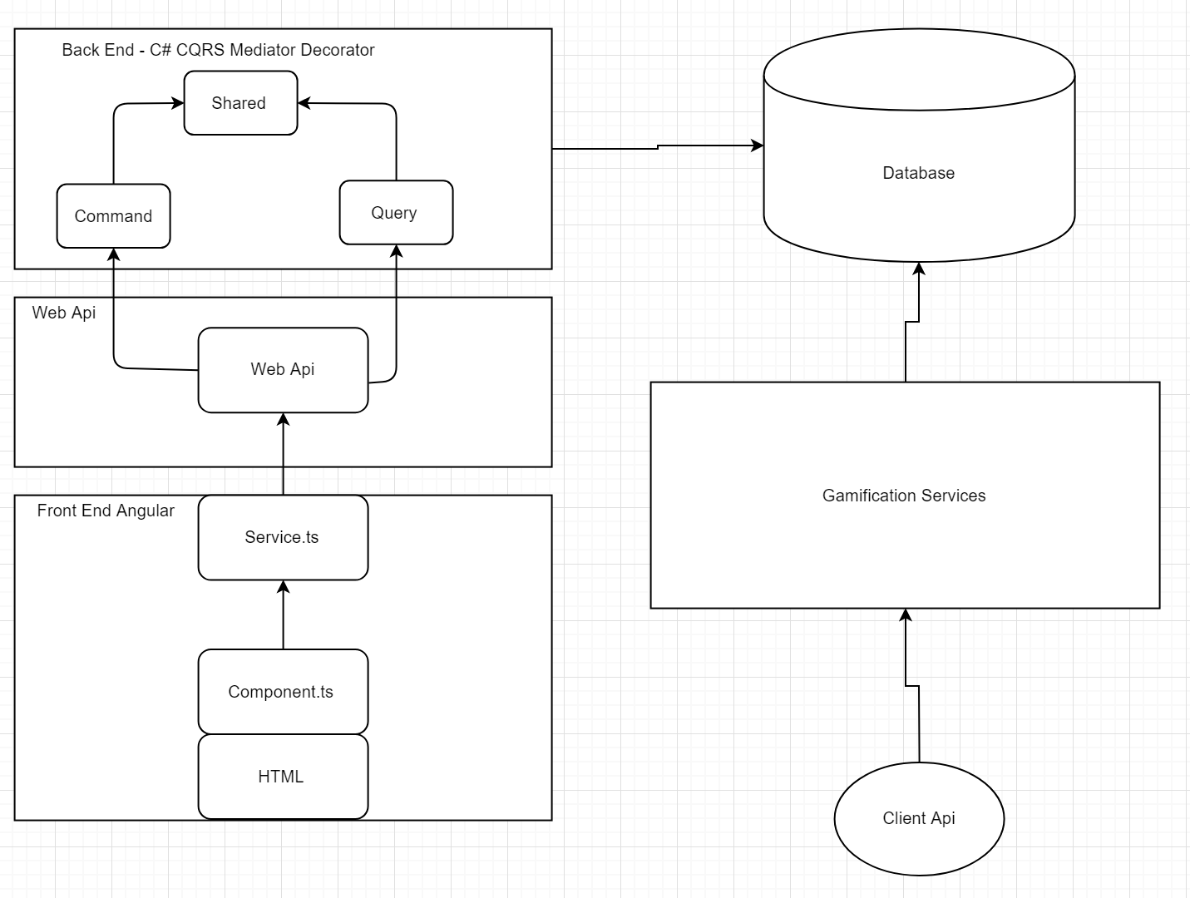
Architecture

Slide 4
Reliability
Due to test cases being written before programing, a test driven approach was taken. Encouraging the software to be designed with reliability in mind. All the initial test cases were tested and passed successfully.
Requirements that were added in the end are not designed as well as the initial requirements that had more time allocated to designing them, but recommendations in the final report on how to fix the reliability and security issues where made.
For example database sharding.
While sharding did increase response time, it added complexity that was not apparent initially. And the design was not fully fleshed out, changing some requirement behavior
Notes:
we basically created separate identical database for each company to decrease the amount of records in one central database where everything would have been.
Creating a new user. There is a user table in the shardmanger used for login, and a user in shard to indicate teams. So there is some duplication, and to add and delete users it must happen in both databases. While one you could just make one transaction and commit it. While this still can be done using a transaction scope allowing changes in multiple database. We use the library to do certain task that doesn't allow ambient transactions. So it was handled in a more crude and error prone fashion.
And then the added requirement of creating new shards adding tables and admin users.

Slide 5
Usability
Due to the nature of gamification web-apps, they are designed to have appealing and convenient user experiences. Therefore one of the main priorities during development was creating an easy to use interface, That sat on top of what the client had already built.
Overall, the application implements all the necessary requirements for a functioning website without any of the missing features that will deteriorate the user experience as is.
The interface was was also verified as it was being developed, the client provided useful user insight due to their experience with the customer.

Slide 6
Demo

